Slide 1
Lyme Awareness Candace Jahelka

Slide 2
My life with Lyme
Constant pain
Oxygen tank
Don’t touch me, No hugging it hurt
Fatigue beyond words
Lyme rage
Emergency room visits
Praying to die
Reading lips because my head pounded so hard I could not hear
Listening to freight trains non stop
Endless doctor appointments
Lyme ruled my life
12 years stolen from myself and my family
I went from living life to existing

Slide 4
Take a moment and silently answer the question: What is Lyme disease?
Think about what you know and how you feel about Lyme disease.

Slide 5
Lyme disease is a bacterial infection caused by Borrelia Burgdorferi.

Slide 6
What it means to someone who is suffering from Lyme
Lyme is:
Isolation
Hopelessness,
Lack of good medical support
Debilitating symptoms
Depression
Feeling like you are a burden to your family and friends

Slide 7
Raise your hand if you think Lyme disease is a new disease

Slide 8
Lyme in History
5300 year old mummy indicated the presence of the Lyme spirochete bacteria
Lyme disease (Trench Fever) was documented during War World 1 and World War II.
Discovered in Lyme Connecticut in 1975
Named in 1981 Borrelia Burgdorferi

Slide 9
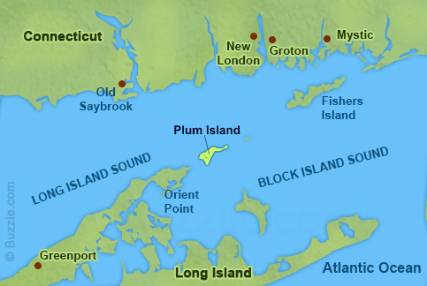
Coincidence?
Lab 257: The Disturbing Story of the Government's Secret Plum Island Germ Laboratory.
Connection between the Plum Island Animal Disease Center and the out breaks of 3 infectious disease including West Nile and Lyme
Plum island is located 1 ½ miles from Lyme Connecticut

Slide 10
Lyme Fact
Lyme disease is the fastest growing vector-borne, infectious disease in the United States according to the CDC
Source: ILIAD http://www.ilads.org/lyme/lyme-quickfacts.php

Slide 11
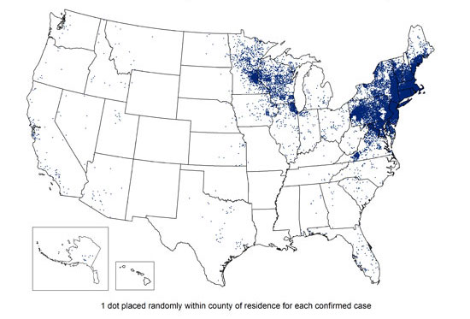
Lyme Fact
In 2013, 95% of confirmed Lyme disease cases were reported from 14 states. Included were Maryland, Delaware, Virginia, Pennsylvania and New Jersey.

Slide 12
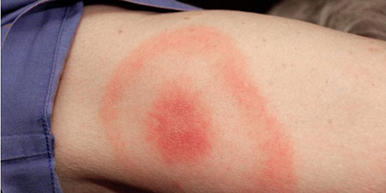
Lyme Fact
Fewer than 50% of patients with Lyme disease recall having a tick bite or bullet rash
It is important to know that the “Bull’s-eye” rash is pathognomonic of Lyme disease and requires no further verification prior to starting an appropriate course of antibiotic therapy.

Slide 13
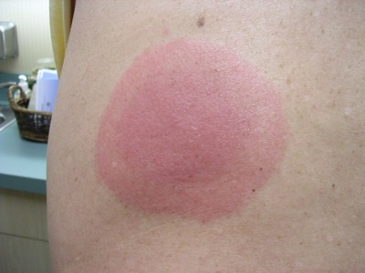
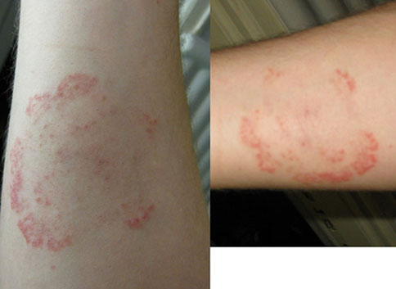
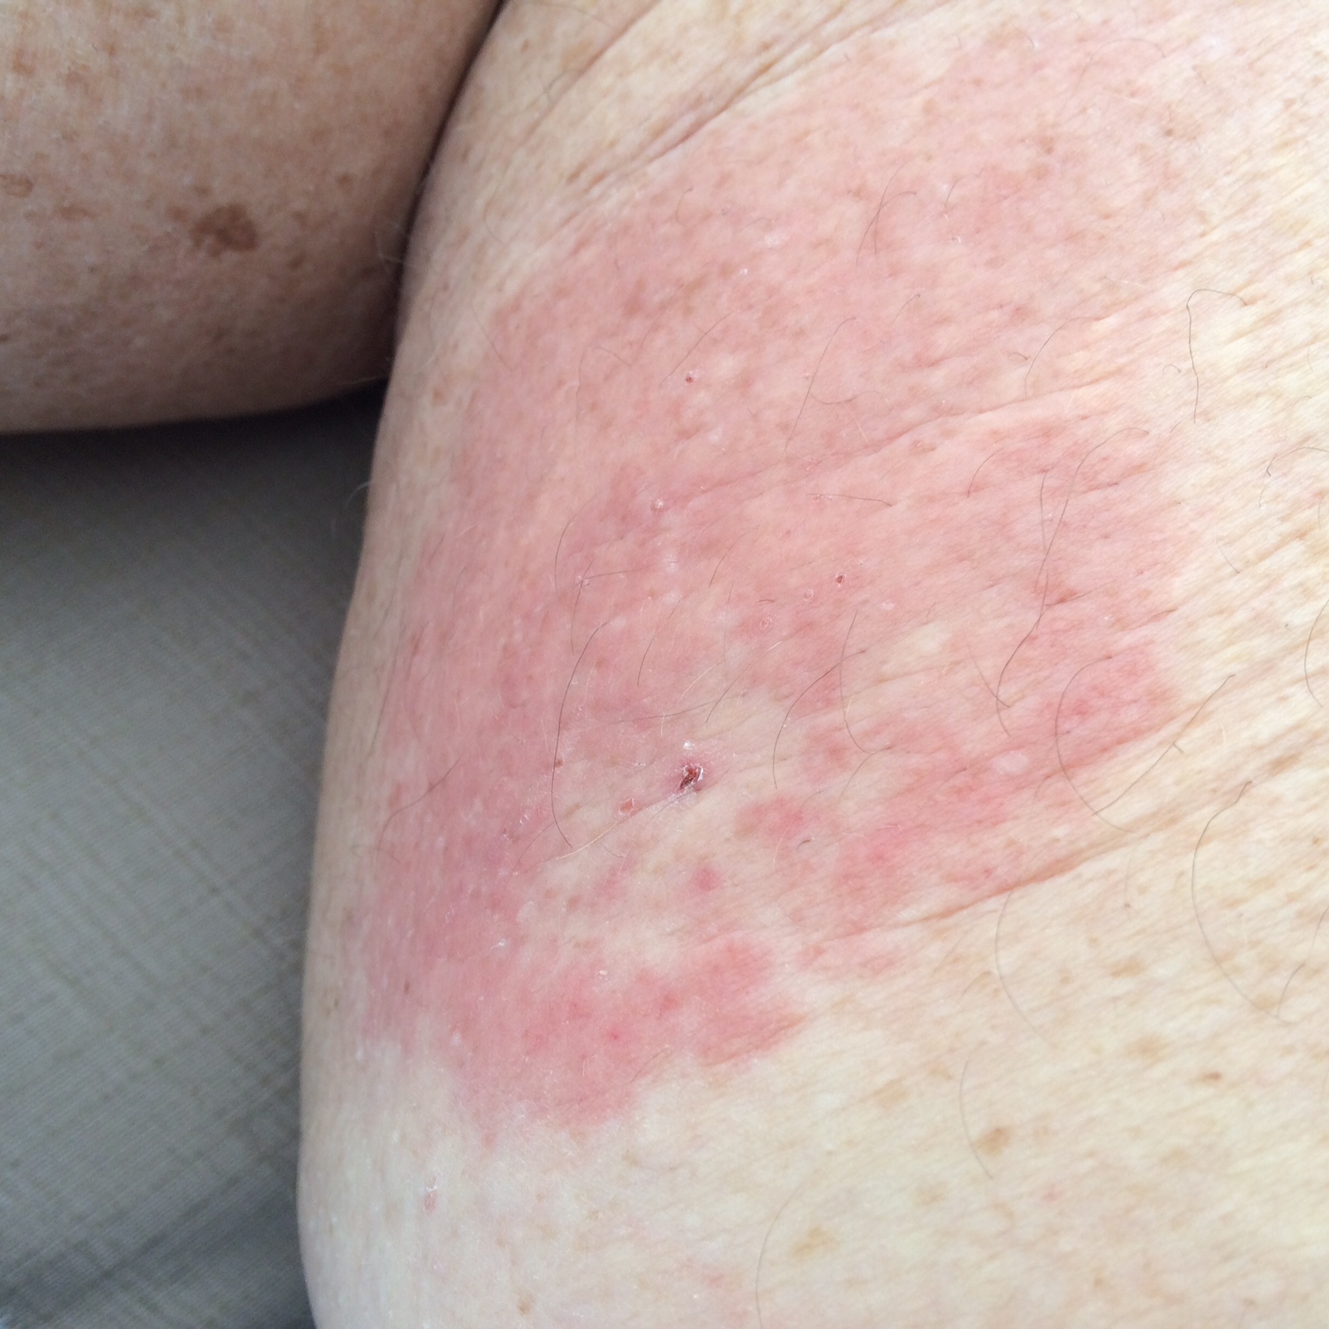
Lyme Fact
Atypical rash forms are more common.
Source: ILIAD http://www.ilads.org/lyme/lyme-quickfacts.php

Slide 14
Lyme Fact
Short courses of antibiotic treatment fail to kill the Lyme spirochete and have resulted in a 40% relapse rate, especially if treatment is delayed.
Source: ILIAD http://www.ilads.org/lyme/lyme-quickfacts.php

Slide 15
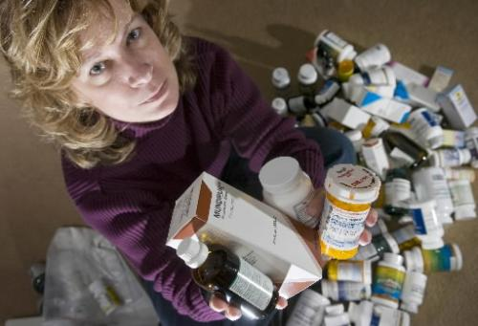
This is typical of a chronic Lyme sufferer.

Slide 16
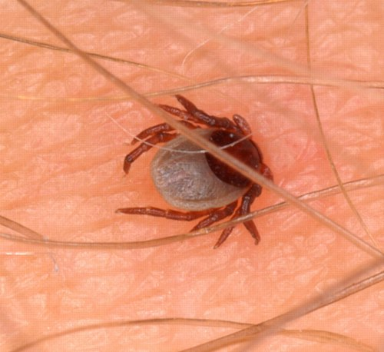
Lyme Fact
The longer the tick is attached, the higher the risk of transmission.
It is still possible to get Lyme disease even if the tick is attached for less than 24 hours.
A flat attached tick means it has not been attached long.
Source: ILIAD http://www.ilads.org/lyme/lyme-quickfacts.php

Slide 17
Lyme Fact
Ages 5-19 are affected 3 times the average rate of all other age groups according to the CDC.

Slide 18
Lyme Fact
Co-infections also need to be recognized. Here is a map showing Rocky Mountain spotted fever.

Slide 19
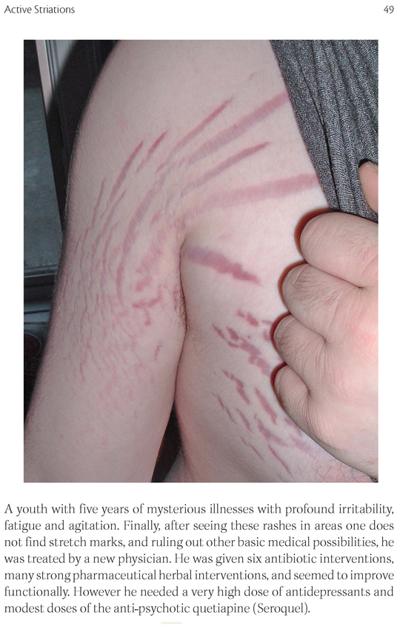
Lyme Fact
Co-infections are as important to treat as Lyme disease.
This is a photo of Bartonella or Cat Scratch fever

Slide 20
How Lyme disease is spread
Any blood sucking insect can carry Lyme disease.
Birds and mice can carry ticks that carry the disease.
New research shows it can be sexually transmitted.
Detected in breast milk, umbilical cords, urine, blood, the cervix, tears, the brain, and other body fluids and tissues.
Our Nations blood supply is not routinely checked for vector borne diseases.

Slide 21
Symptoms
Headache
Debilitating fatigue
Fever
Joint pain
Skin rashes
Back pain
Blurred vision & eye pain
Chest pain & palpitations
Depression
Facial numbness, pain tingling & palsy
Flu-like symptoms
Irritability and mood swings
Gut issues, gas bloating
Jaw pain
Light headnesses, dizziness
Memory loss, poor concentration
Night sweats
Weight change

Slide 22
3 Forms of Lyme

Slide 23
Finding a Lyme literate doctor is at best a challenge

Slide 24
How not to remove a Tick
DO NOT:
Try to smother a tick with petroleum jelly, essential oils, nail polish or nail polish remover, dish detergent, or any thing else that would agitate the tick and cause it to pull itself out.
Grab it at the body and squeeze to pull out.
Use the heat of the blow dryer or burning match to get the tick to back out.

Slide 25
Correct Tick Removal

Slide 26
Head of Tick. What is embedded in the skin
A magnified mouth of a tick

Slide 27
2 tick removing products
Tick twister
Pro Tick Remedy

Slide 28
What to do after you remove the tick
Use antiseptic on skin or antibiotic cream
Disinfect tweezers
Wash hands thoroughly
Call a physician immediately if you show any type of rash at the site
Save the tick in a zippered plastic bag or closed container with a moist cotton ball or paper towel. Date it. Place in the refrigerator. Ticks can be tested by Igenex or with a tick kit you can purchase

Slide 29
Tick prevention

Slide 30
Make your home a tick free zone

Slide 31
Protect yourself

Slide 32
Tick preventative clothing
Wear Tick Repellant Clothing. Lasts for up to 70 washings and is better for people with chemical sensitivities.
Treat clothes with Permethrin or Pyrethroid. This will last for up to 2 weeks.
Wear a hat and tie back long hair to make it harder for ticks to attach to your scalp.
Use duct tape wrapped inside out around the ankles to trap ticks attempting to crawl up your legs.
Wear EPA-approved repellants appropriate for adult skin or children. Follow the manufacturer’s instructions for application carefully; some repellants are designed for application to clothes and equipment only.
Ticks cannot survive the dry heat. Skip the washing machine and use the high heat setting of the dryer to kill ticks.
Stay in the center of trails, avoiding contact with overhanging grass and brush, while walking in the woods.

Slide 33
Tick prevention tips
Plant tick repellent plants, which include lavender, garlic, pennyroyal, pyrethrum (type of chrysanthemum), sage, American beautyberry and Eucalyptus.
Chickens, ducks, guinea hens and even wild birds are great tick eaters
You can attract insect-eating birds by planting “insectary” plants. Insectaries are plants such as dill, Dutch white clover, and New England aster that attract large numbers of beneficial insects such as butterflies and bees.
Locate bird feeders away from your tick free zone and keep food in mouse proof containers to avoid spreading ticks in your yard by birds and mice

Slide 34
Diatomaceous Earth
Food grade only
DE has razor-sharp edges that are not good for tiny insects. These edges slice through a flea's outside covering; they dehydrate and die.
Give your pets a dry powder bath with DE before entering the home or before going outside.
Works on many types of insects.
Apply to your yard about 6 ounces for 500 square feet of lawn. Diatomaceous earth works better in dry rather than humid conditions. Reapply after heavy rains.
Don't breathe in the powder! Diatomaceous earth is not toxic to humans or pets, but can harm your lungs if you breathe it in.

Slide 35
Other prevention ideas
Take vitamin B1 daily causes human beings to emit an odor that resists ticks to some degree. Humans can’t smell it.
Eating garlic keep bugs away. Or take freeze dried garlic
A vitamin B patch, which is also safe for children, may also be effective. It is waterproof and lasts up 36 hours. One product is called "Don't Bite Me Patch".
Ticks do not like lavender. Use products that contain lavender, soap, laundry detergent and lotions

Slide 36
Take Aways
We need to be aware of Lyme Disease
Lyme disease can be debilitating for individuals and their family
The lawyer I used to help me with my business was so excited to help because she helped individuals file bankruptcy due to Lyme disease
There is lot of information and misinformation out there
Support is out there! You are not alone if you have Lyme disease
I’m living, breathing proof that Lyme disease does not need to stop you from living life and existing

